Slide 1
E-Asset-Management System
Group project for Code Fury
-Team Code Genesis

Slide 2
Presenting Code Genesis
Priyambada Upadhyay
Ayushi Tripathi
Princy Sultania
Riya Khanna
Disha Rastogi
Rahul Ghosh (Team Lead )
Kunal Prahlad More
Snehal Anil Gunjal
Avanti Kamal
Simran Tannu

Slide 3
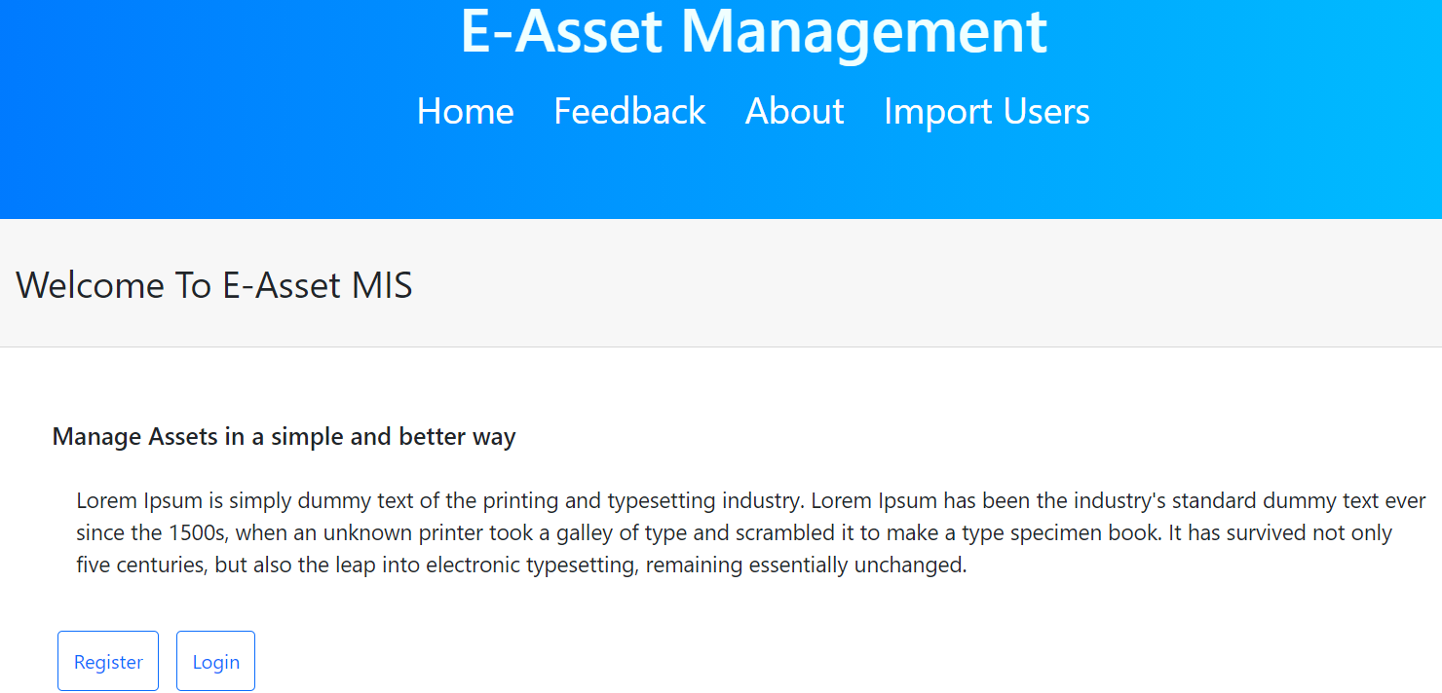
Introduction
The E-Asset Management system is a web based application to keep track of several assets that can be borrowed, their availability, the current borrower and the asset history.
Assets include Laptops, Books, Mobiles and Devices w.r.t their category.

Slide 4
Application Features
Register , Login , Feedback
01
Home
Login as User/ Admin
Login
02
View User Info , Add Asset , Add Asset Category , OverDue Asset Management, Import Users
03
Admin
Borrow Asset
User
04

Slide 5
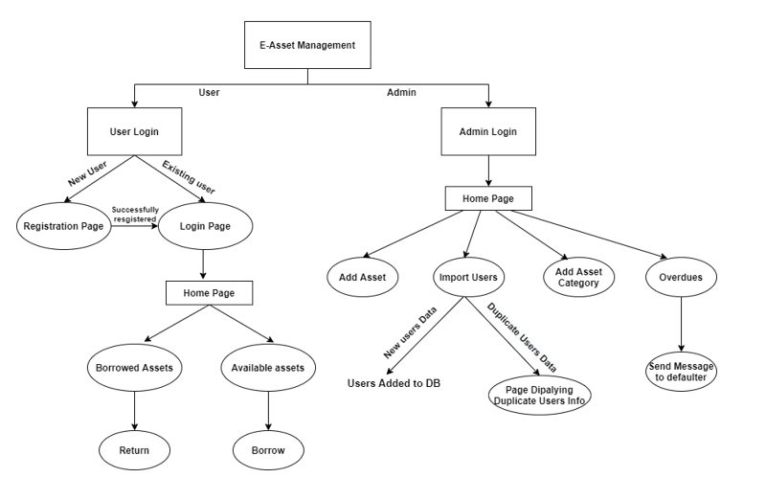
Data Flow Diagram

Slide 6
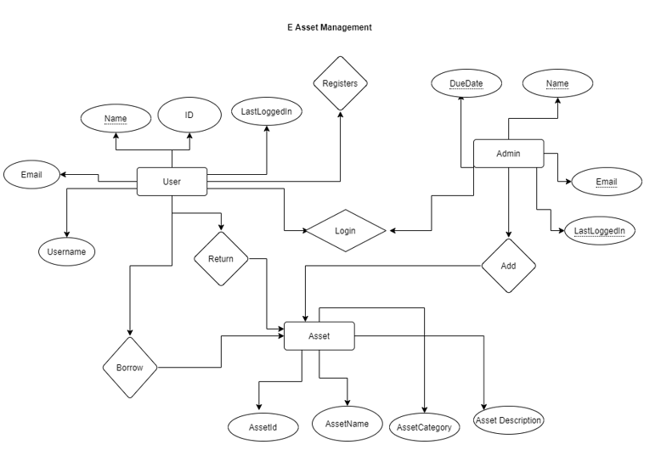
Entity Relationship Diagram

Slide 7
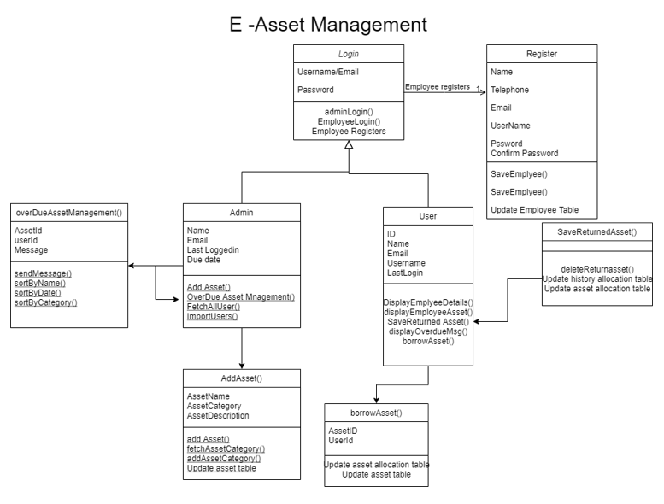
UML Diagram

Slide 8
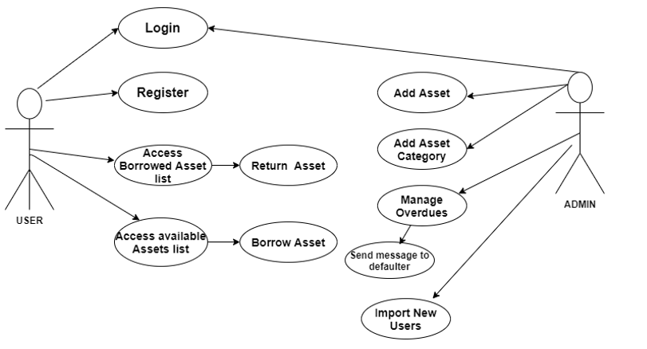
Use Case Diagram

Slide 9
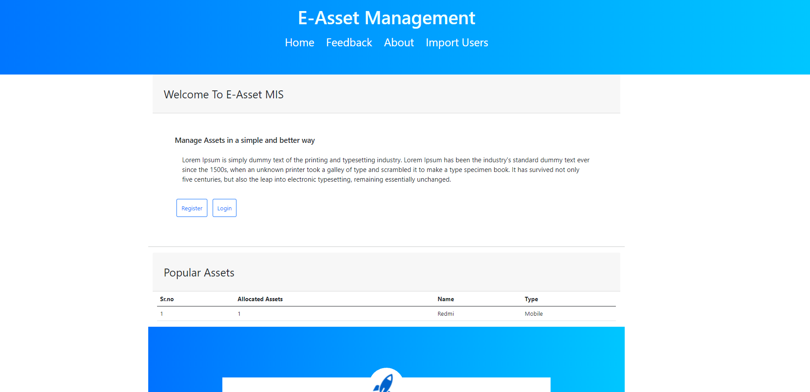
Home Page

Slide 10
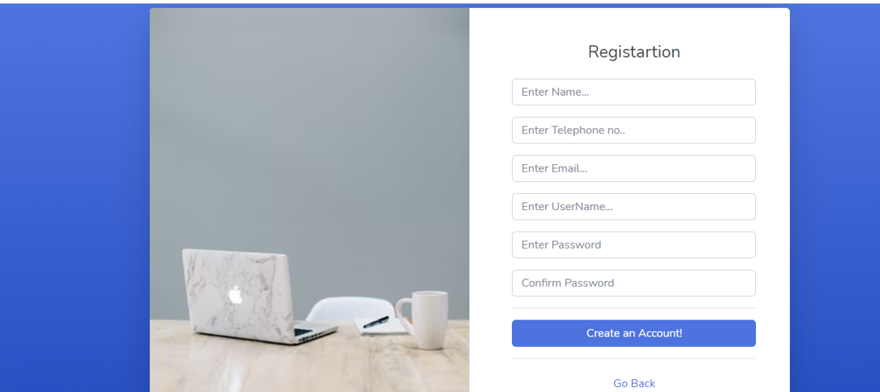
Registration

Slide 11
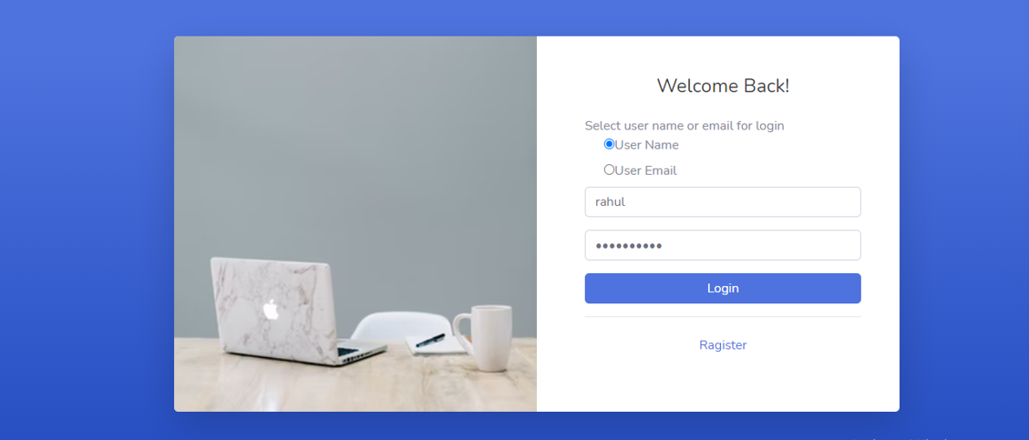
Login

Slide 12
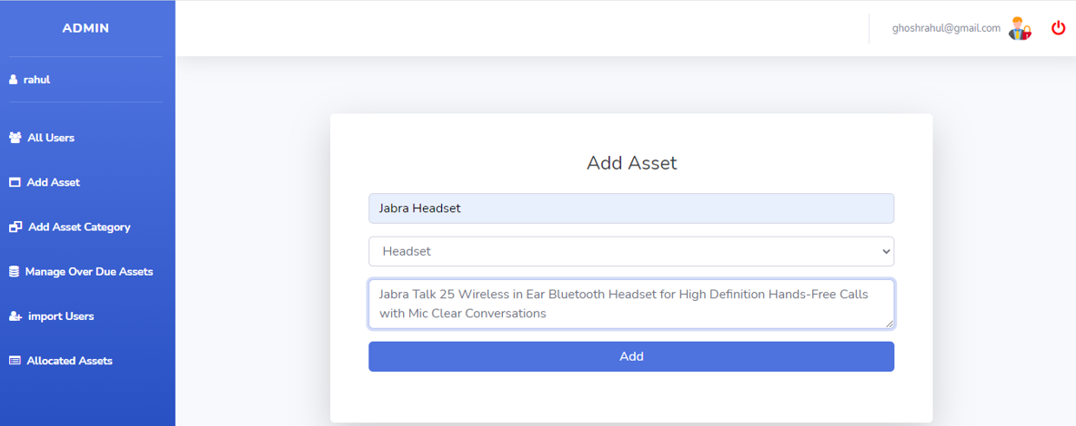
Admin-Add Asset

Slide 13
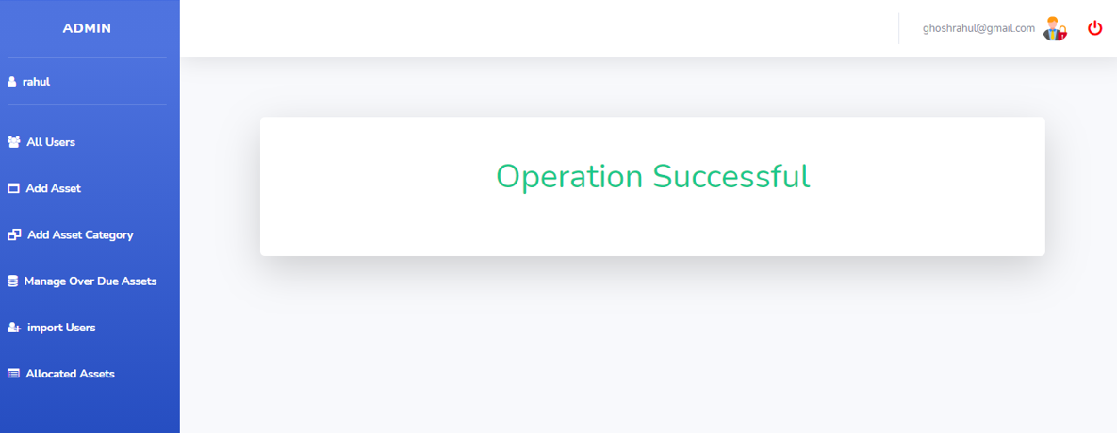
Admin-Add Asset (Successful)

Slide 14
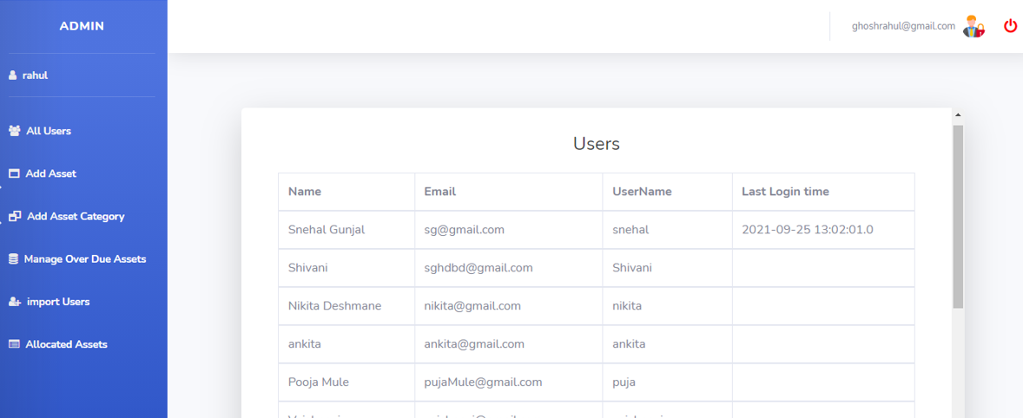
Admin- Show All Users

Slide 15
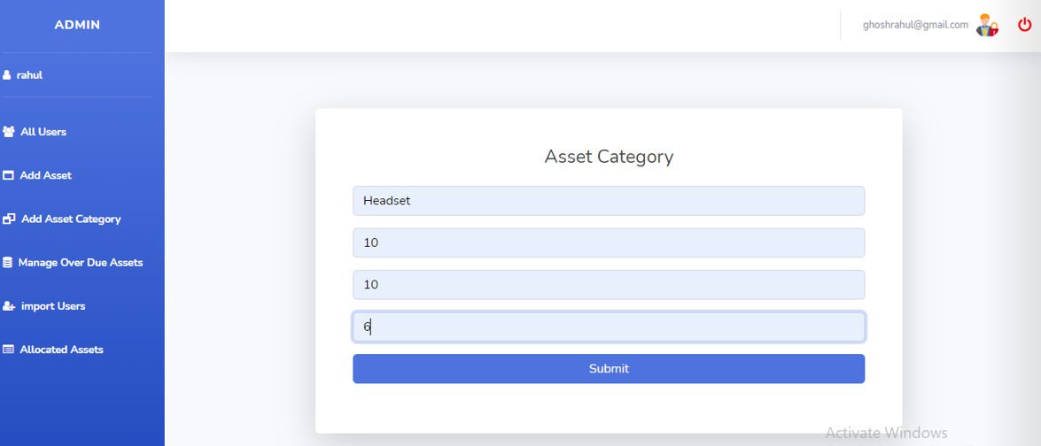
Admin-Add Asset Category

Slide 16
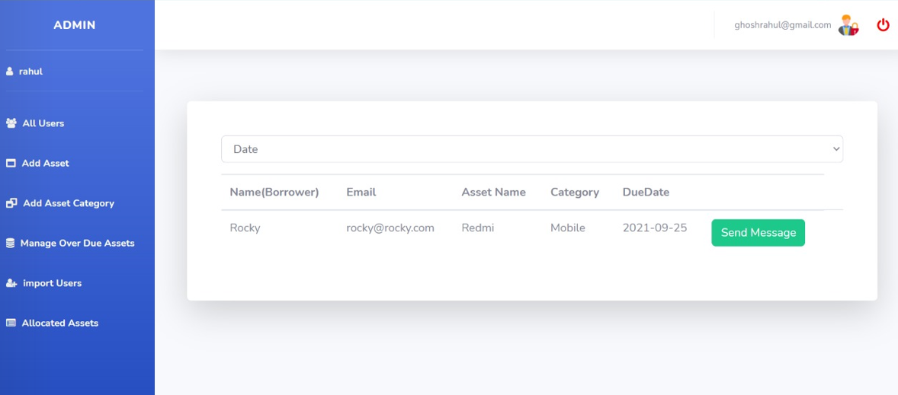
Admin-Asset OverDue Management

Slide 17
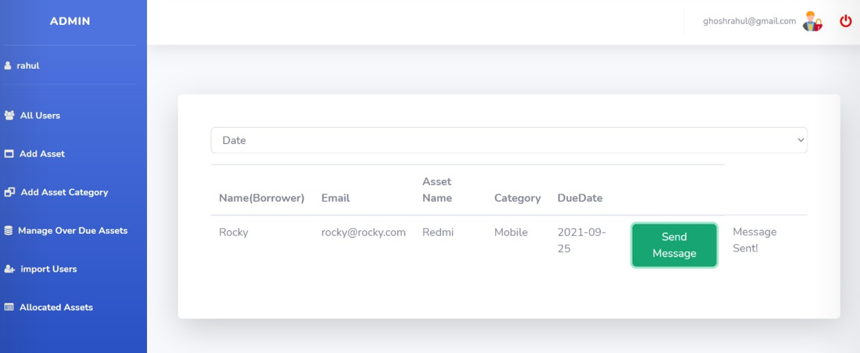
Admin-Asset OverDue Management

Slide 18
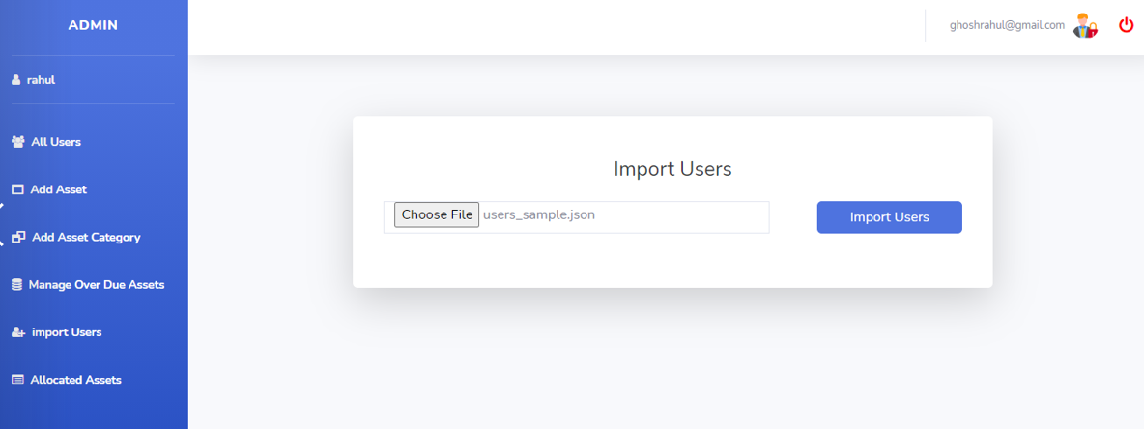
Admin-Import Users

Slide 19
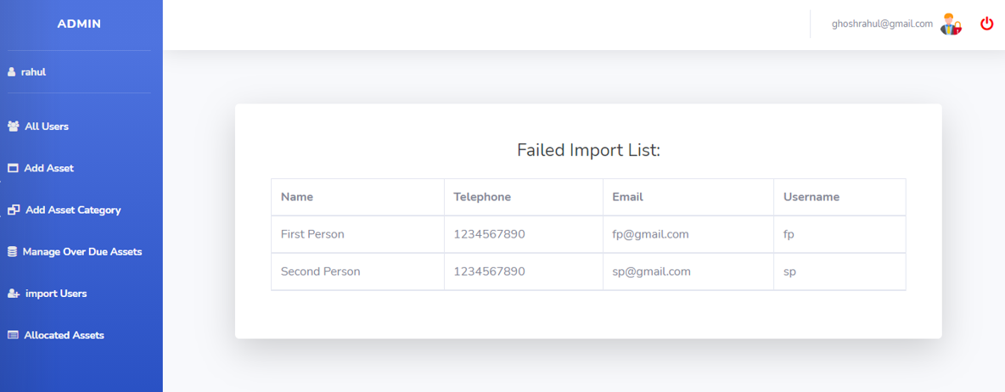
Admin-Import Users

Slide 20
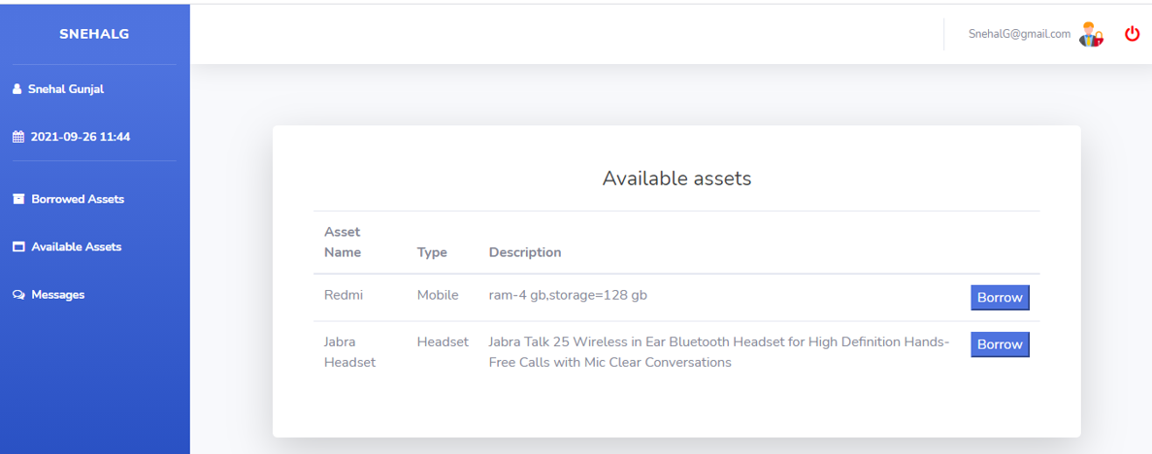
User - Available Assets

Slide 21
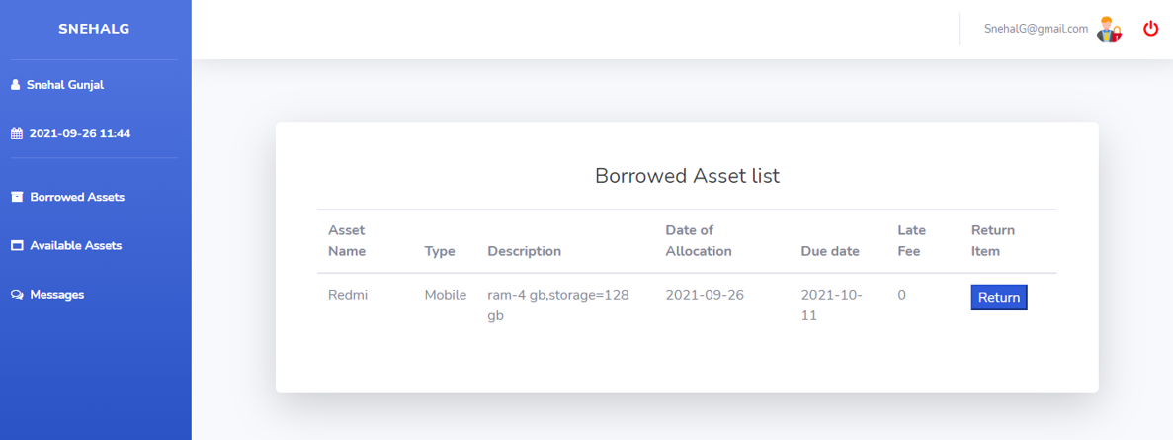
User - Borrowed Assets

Slide 22
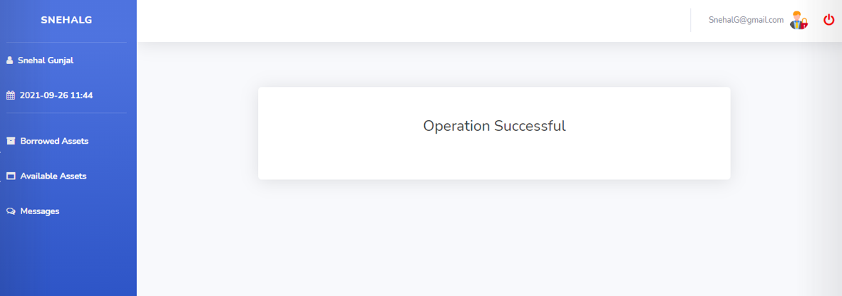
User - Borrow Successful

Slide 23
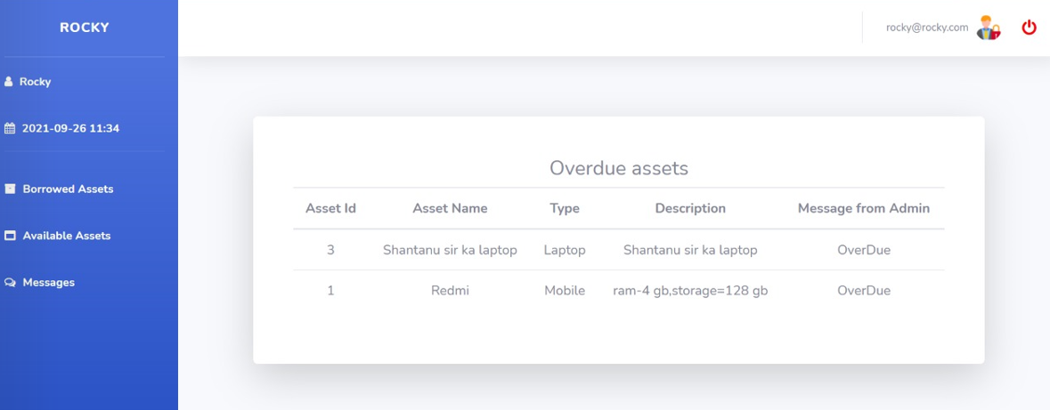
User - Messages (Overdue)

Slide 24

Key Learnings
Java
Layered Architecture
Jdbc
Jsp
Mysql

Slide 25

Tools Used
Java
MariaDB
STS 4 IDE
GIT

Slide 26
Thank You !

